Slide 1

DIGITAL SIGNAL PROCESSING
IN
VIDEO SIGNAL
GROUP - 5
26
29
43
45
48
Ansh Magon
Varad Ashtekar
Kapil Bhale
Sarang Bhanap
Shreyash Bhatkar

Slide 2

CONTENTS
VIDEO SIGNALS
TYPES OF VIDEOS
01
04
Introduction to Video Signals & Processing
Types of Video: Composite and Component Video
VIDEO OPERATIONS
ANALOG VIDEO RASTER
02
05
Video Formation, Perception, Color Perception, Light and Color
Analog Video Raster & it’s characteristics.
DIGITAL VIDEO
03
PRINCIPLES OF COLOR VIDEO IMAGING
06
Digital Video and it’s parameters.

Slide 3
CONTENTS
VIDEO PARAMETERS
VIDEO QUALITY
07
10
Video Quality Measure
VIDEO SAMPLING
CONCLUSION
08
11
Video Sampling
Summary of the Topic
VIDEO CODING
REFERENCES
09
12
Video Coding
Sources of information

Slide 4


VIDEO SIGNALS
Introduction
Types
Interlacing
Attributes
Sources of Light

Slide 5
VIDEO SIGNALS
A video signal is a sequence of 2D images, projected from a dynamic 3D scene onto the image plane of a video camera.
480p
720p
576p
1080p
TYPES OF
VIDEO SIGNALS

Slide 6
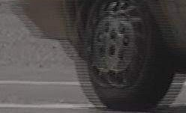
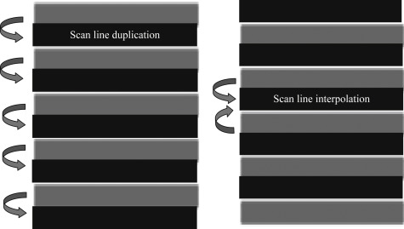
INTERLACING
Interlaced frame
Methods to interlace

Slide 7
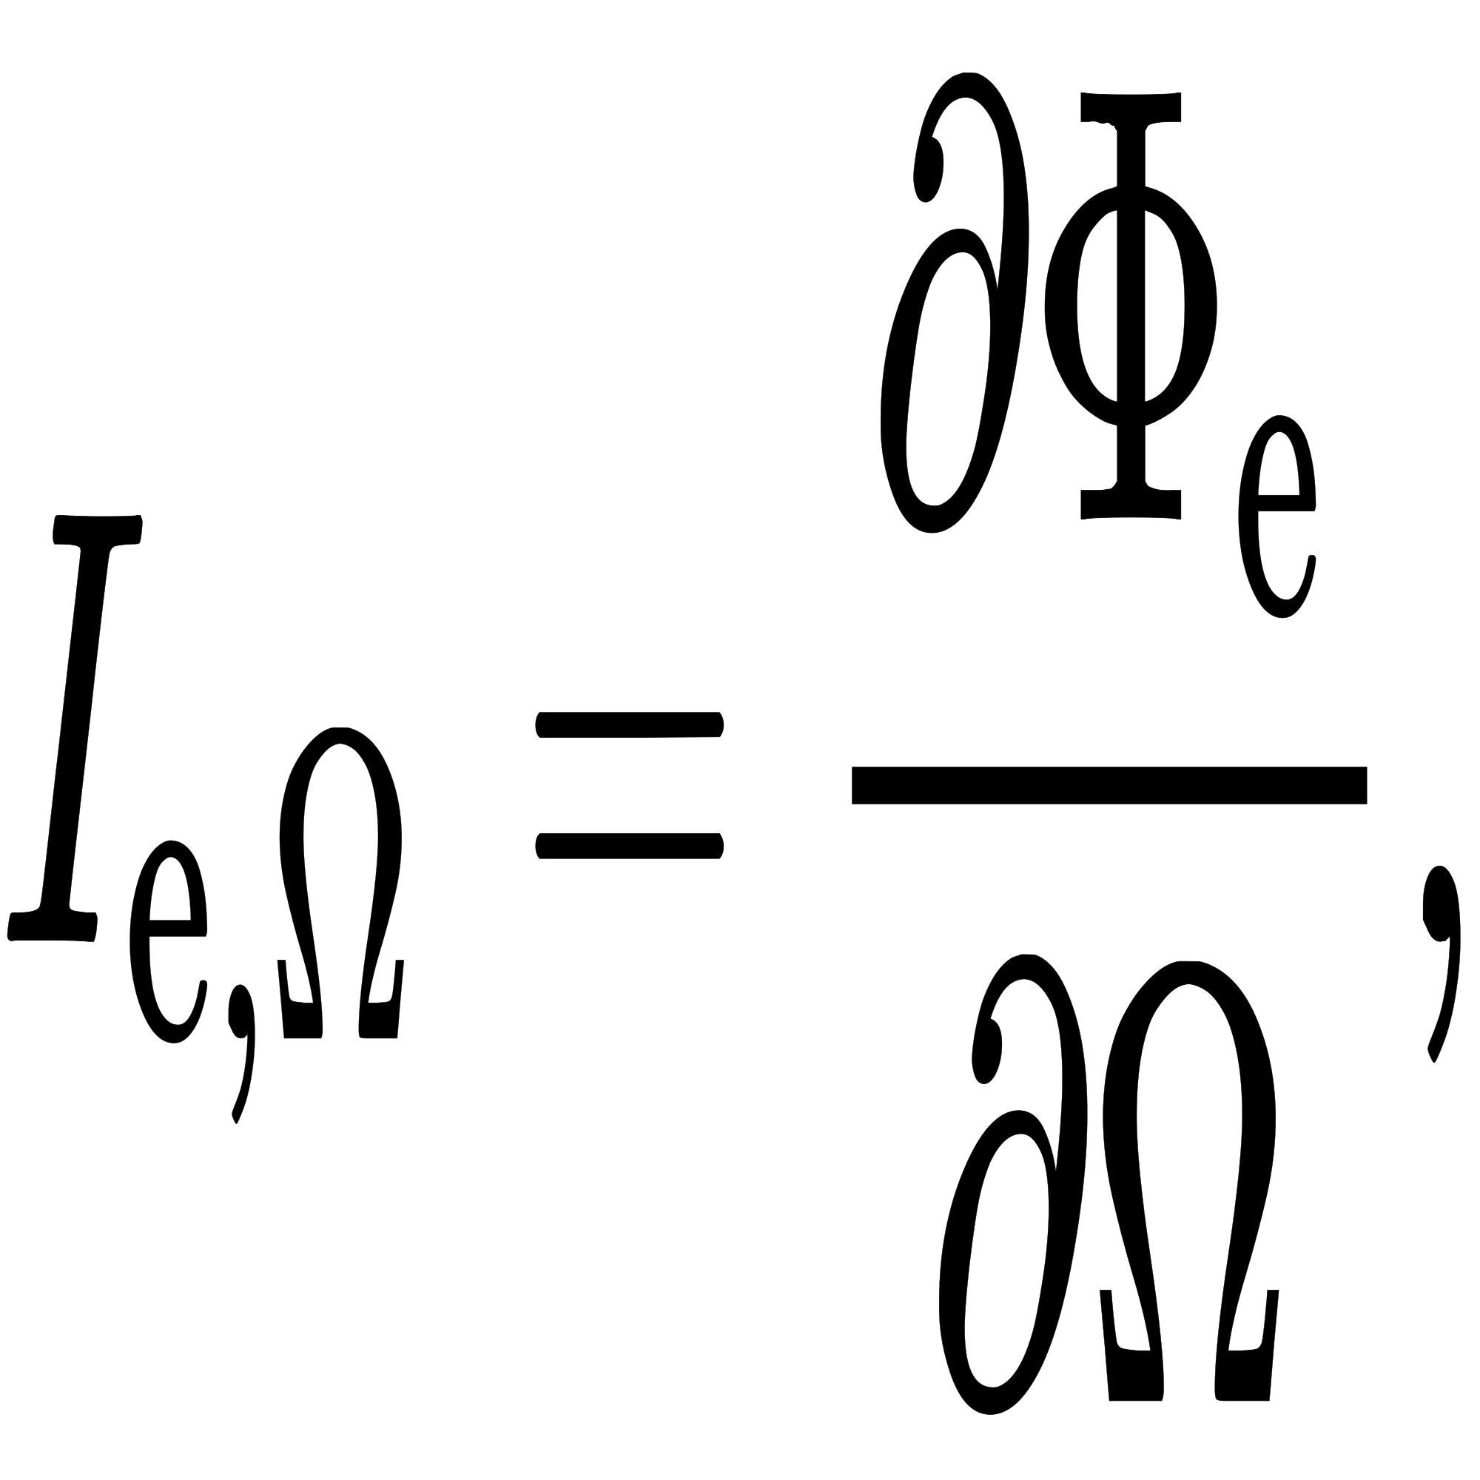
ATTRIBUTES OF VIDEO SIGNALS
COLOR PERCEPTION & SPECIFICATION
LIGHT AND COLOR
RADIANT INTENSITY
The color value at any point in a video frame records the emitted or reflected light at a particular 3-D point in the observed scene.
Light consists of an electromagnetic wave with wavelength from 380nm - 780nm.
Energy of light is measured by ‘Flux’ In watts
It’s our perception of light.

Slide 8
SOURCES OF LIGHT
ILLUMINATING SOURCES
REFLECTING LIGHT
The perceived color of an illuminating light source depends on the wavelength range in which it emits energy.
They emit an electromagnetic wave. Such sources include the sunlight bulbs, TV monitors & so on
Illuminating light follows an additive rule
A sources that reflect an incident light could itself be a reflected light.
When a light beam hits an object, the energy in a certain wavelength range is absorbed, while the rest is reflected.

Slide 9
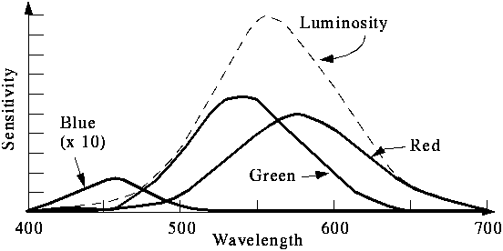
COLOR IN VIDEO
Most light we see is not one wavelength, it's a combination of many wavelengths.
A color can be specified as the sum of three colors. So colors form a 3 dimensional vector space.
A color image is a 2-D array of (R,G,B) integer triplets
There are two types of Color Modes:
1. RGB Color Mode
2. CMY Color Mode

Slide 10
TYPES OF VIDEO
COMPONENT VIDEO
COMPOSITE VIDEO
This kind of Video splits into 3 parts – red , green, blue, each transmitting different information.
It support high-definition video and has a modern outlook.
They are replacing composite Video.
.
A composite video — also known as an RCA or “yellow plug” cable — is an old standard that transfers a video signal.
The cables also suffer from radio frequency interference, which further degrades picture quality.
The only practical use for composite video today is when using older equipment

Slide 11
ANALOG VIDEO RASTER
Introduction
Scanning Methods
Characterization of Raster

Slide 12
ANALOG VIDEO RASTER
Analog video systems of today use raster scan for video capture and display.
In a raster scan, a camera captures a video sequence, by sampling it in both temporal and vertical directions.
The resulting signal is stored a continuous 1-D waveform.

Slide 13


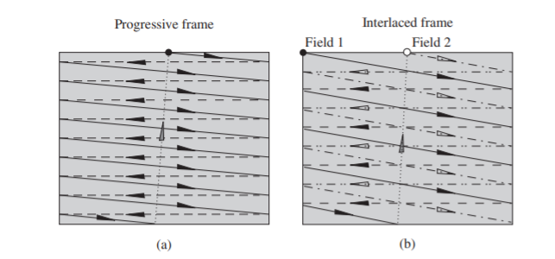
SCANNING METHODS
01
02
PROGRESSIVE SCAN
INTERLACED SCAN
A frame is formed by a single scanning pass.
The electronic beam continuously scans the image region from top to bottom and then back to top.
In the interlaced scan, each frame is scanned in two fields
Each field contains half the number of lines in a frame.
The time interval between two fields, that is, the field interval, is half of the frame interval.

Slide 14
CHARACHTERIZATION OF RASTER
01
03
FRAME RATE
LINE RATE
02
fs,t (frame/sec or fps or Hz)
f1 (lines/sec) = : fs,t, fs,y
LINE NUMBER
fs,y
(lines/frame or lines/picture height)

Slide 15
DIGITAL VIDEO
Digital video is an electronic representation of moving visual images in the form of encoded digital data.
All video formats will have a specific setting, components or value for each video parameters.

Slide 16
VIDEO PARAMETERS
01
03
FRAME RATE
ASPECT RATIO
02
04
RESOLUTION
PIXEL ASPECT RATIO

Slide 17
VIDEO SAMPLING
The digitization process of a continuous video signal involves sampling and quantization.
For 2D signals, samples are normally taken on a rectangular grid. These grids are known as lattices.
When designing a video sampling system we need to decide the following:
1. Sampling frequencies
2. Sampling rate
3. Methods to avoid aliasing

Slide 18
VIDEO SAMPLING
Requirements of Video sampling are:
1. Choice of necessary sampling rates for video
2. Choice of a suitable efficient sampling lattice under a given total data or sampling rate.
To sample each line, the horizontal sampling interval should match the vertical interval, so that the resulting pixels are square
After sampling from analog to digital, video signal is converted from one format to another

Slide 19
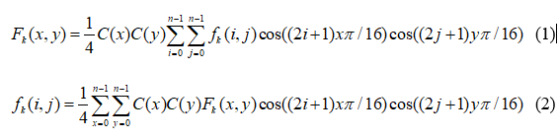
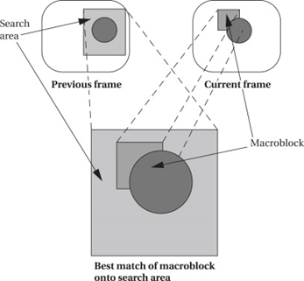
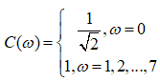

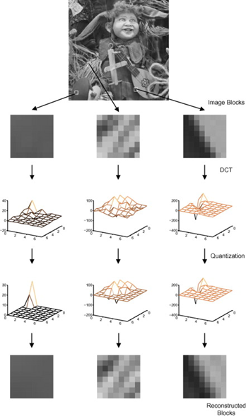
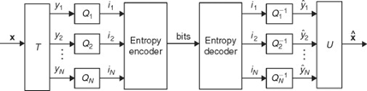
VIDEO CODING
QUANTIZATION FUNCTIONS
ENTROPY CODING
The is the inevitable result of representing a value as a number with a fixed number of decimal places
It is a lossless data compression scheme independent of the medium. It is executed on quantization results from each macroblock.
It impacts CR and PSNR values.
TRANSFORMATION FUNCTIONS
MOTION ESTIMATION
They convert the images/frame data from the spatial domain into the frequency domain.
DCT is applied.
It encodes the frame data by modified forms of other frames.
The motion vector is calculated through search algorithms.

Slide 20
REFERENCES
https://nptel.ac.in/courses/117/104/117104020/#
https://towardsdatascience.com/the-overview-of-video-coding-technique-f650aed6c6a4
Interlacing , by Michael Parker
https://www.sciencedirect.com/topics/computer-science/digital-video-processing
https://www.coursera.org/learn/digital
https://en.wikipedia.org/wiki/Video_processing
https://www.researchgate.net/publication/200132428_Digital_Video_Processing

Slide 21

THANKS!
Do you have any questions?
Feel free to ask them.

